Slide 1
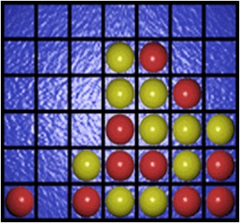
Industrial Training Presentation
On
The Connect4 Game

Slide 2
Table of content
About the Organization
Getting started with Java
Technology and IDE used
Training Highlights
Preformance Report and Certificate

Slide 3

About the organization
What is Internshala?
Internshala is a dot com business with the heart of dot org.
They are a technology company on a mission to equip students with relevant skills & practical exposure through internships and online trainings. Imagine a world full of freedom and possibilities. A world where you can discover your passion and turn it into your career. A world where your practical skills matter more than your university degree. A world where you do not have to wait till 21 to taste your first work experience (and get a rude shock that it is nothing like you had imagine it to be). A world where you graduate fully assured, fully confident, and fully prepared to stake claim on your place in the world.

Slide 4

Getting started with java
It is quite interesting to know the development of Java technology, which is widely accepted in the area of networked/distributed computing. Java evolved from a project developing a language for programming consumer electronic devices at Sun Microsystems, USA. According to Sun, Java is defined as a simple, object-oriented, distributed, interpreted, robust, secure, architecture –neutral, portable, high performance, multithreaded, and dynamic programming language and platform.

Slide 5
Technology and ide used
Java is a technology consisting of both a programming language and a software platform. To create an application using Java, you first write the program in the Java programming language, then compile the program into Java bytecode—the instruction set for the Java Virtual Machine (JVM) to use at runtime. Java bytecode runs without modification on any system that supports JVMs—it’s the origin of the “write once, run many” (WORM) expression used by Java aficionados.
The Java software platform consists of the JVM, the Java API, and a complete development environment. The JVM parses and runs (interprets) the Java bytecode. The Java API consists of an extensive set of libraries including basic objects, networking and security functions; XML generation; and web services. Taken together, the Java language and the Java software platform form a powerful, proven technology for enterprise software development.

Slide 6

Jet brains
IntelliJ IDEA is an IDE for Java, it also understands and provides intelligent coding assistance for a large variety of other languages such as SQL, JPQL, HTML, JavaScript, etc., even if the language expression is injected into a String literal in your Java code.

Slide 7

Tools needed
·Linux 7.1 or Windows 8 or above operating system
·Java JDK 8 or above
Microsoft Notepad or any other text editor(IntelliJ Idea)

Slide 8
Training highlights
The Core Java Training by Internshala is a 6-weeks online training program covering the basic concepts of Java and Object-Oriented Programming such as arrays, methods, and inheritance, polymorphism, classes etc. As a part of the project, students will learn about Java FX and develop an awesome game using the same concepts. You will learn through video tutorials. For great hands on learning experience, this training program is packed with assignments, assessment tests, and exercises.

Slide 9
The Connect4 game
Connect Four is a popular two-player connection game in which the players first choose a color and then take turns dropping one colored disc from the top into a seven-column, six-row vertically suspended grid. The pieces fall straight down, occupying the lowest available space within the column. The goal of the Connect Four game is to be the first player to form a horizontal, vertical, or diagonal line of four of one’s own discs. Connect Four is a solved game. Thus, the first player can always win by playing the right moves.

Slide 10

Game Rules
Connect Four is a two players game which takes place on a 7x6 rectangular board placed vertically between them. One player has 21 yellow coins and the other 21 red coins. Each player can drop a coin at the top of the board in one of the seven columns; the coin falls down and fills the lower unoccupied square. Of course a player cannot drop a coin in a certain column if it's already full (i.e. it already contains six coins).

Slide 11
Project designing
Creating a JavaFX program begins with the Application class, from which all JavaFX applications are extended. Your main class should call the launch() method, which will then call the init() method and then the start() method, wait for the application to finish, and then call the stop() method. Of these methods, only the start() method is abstract and must be overridden.
The Stage class is the top level JavaFX container. When an Application is launched, an initial Stage is created and passed to the Application's start method. Stages control basic window properties such as title, icon, visibility, resizability, fullscreen mode, and decorations; the latter is configured using StageStyle. Additional Stages may be constructed as necessary. After a Stage is configured and the content is added, the show() method is called.

Slide 12
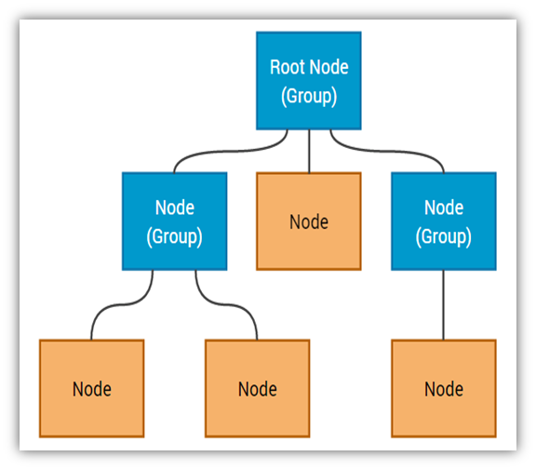
Structuring content
A general element of a scene graph in JavaFX is called a NodeEvery Node in a tree has a single "parent" node, with the exception of a special Node designated as the "root". A Group is a Node which can have many "child" Node elements.
We can set the controller class for the FXML document. The FXML controller class can bind the Graphical User Interface components declared within the FXML file.

Slide 13
Project modules and functionalities
Connect4 Game UI
Creating Playground
Inserting Discs
Deciding the Winner
Game Over
Final Result

Slide 14
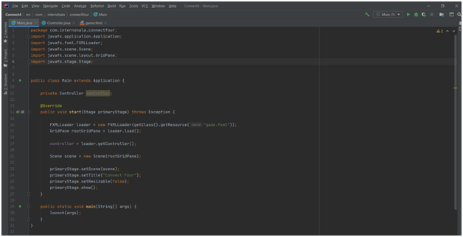
Connect4 game ui
As we create a java-FX project it includes three different files,
Main.java
Controller.java
Game.fxml

Slide 15
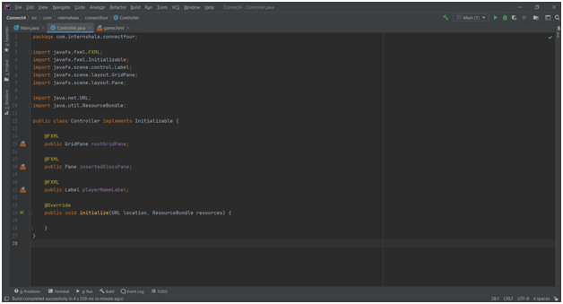
controller
Here we can see the controller field it consists all the controls which is given in the game.fxml file . These field consists initialization of the controller and the code has been done in the game.fxml file.

Slide 16
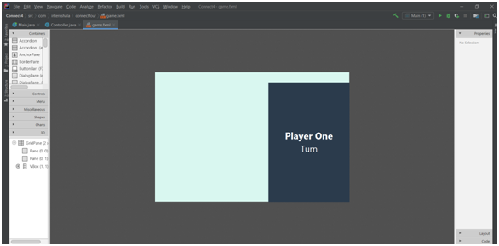
Fxml file
Basically game.fxml file contains two fields first one text field and the second one scene builder field .In these field whatever controls we are given (such as drag and drop) it will create its code itself it means when we perform drag and drop operation in text field IntelliJ will create its code automatically in the backend side.

Slide 17
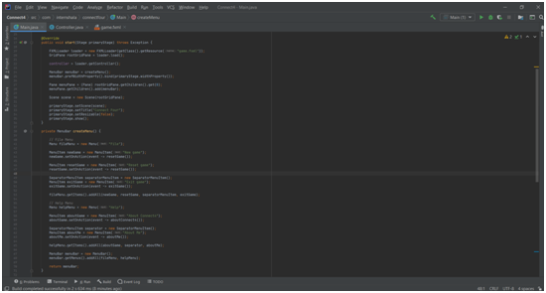
Creating menu
In these field we can define all the functions of the menu bar including its items.

Slide 18
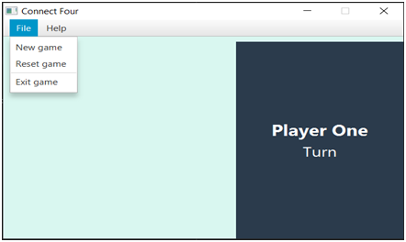
Output after adding menu

Slide 19
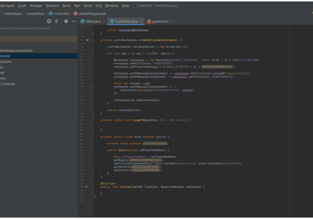
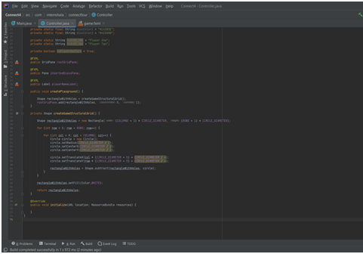
Creating playground
In these module we can work on the middle field of the code where we can add rectangle and circle and its relevant code . These is the user interaction phase .

Slide 20
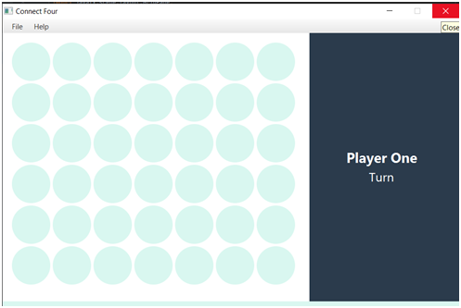
Output after playground is completed

Slide 21
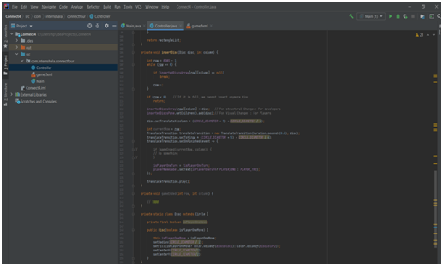
Inserting discs
In these module we can show that how the circle will move from one line to another .

Slide 22
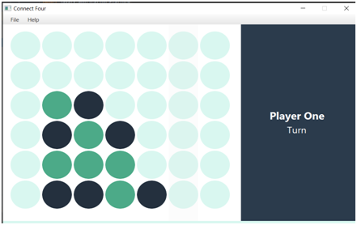
Output after inserting the discs

Slide 23
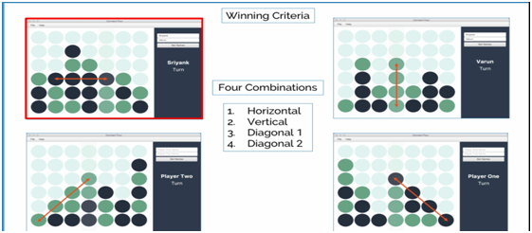
Deciding the winner
The object of the game is to connect four coins vertically, horizontally or diagonally. If the board is filled and no one has alligned four coins then the game is drawn (i.e. after 42 moves if no one wins).

Slide 24
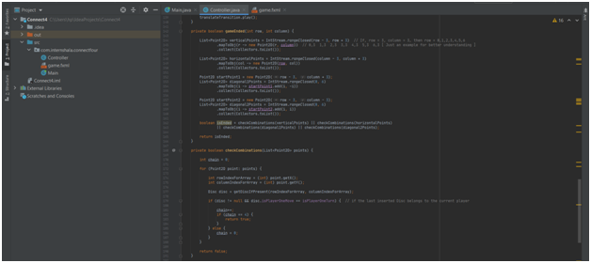
Code for deciding the winner

Slide 25
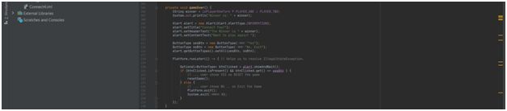
Game over
Code is given below

Slide 26
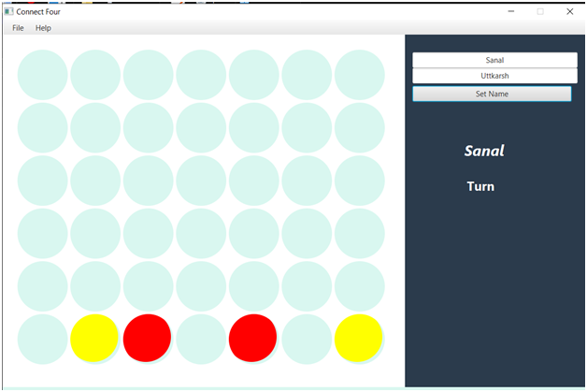
Final result
At the end the Connect4 application is up and running.

Slide 27

Trainiee description
Submitted By: Sanal Mishra
Roll No: 181500615
Department Of Computer Engineering And Application

Slide 28
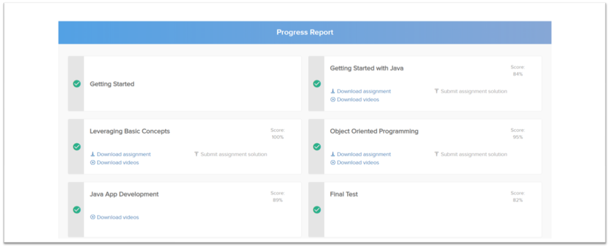
Performance report

Slide 29
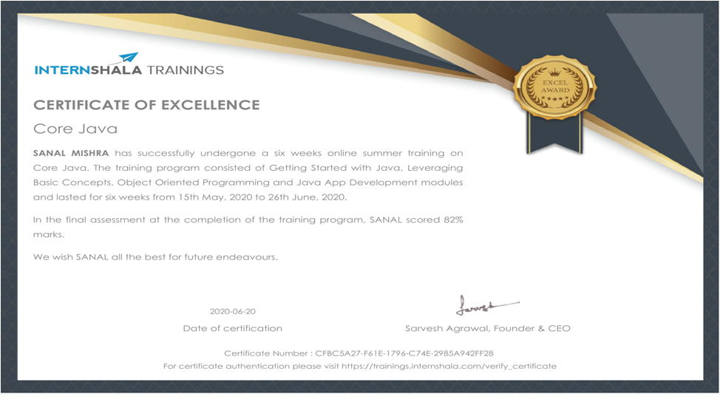
certificate

Slide 30


